Slide 1

Molecular Dynamics of a Lennard-Jones Fluid
By: Neil Mitra

Slide 2
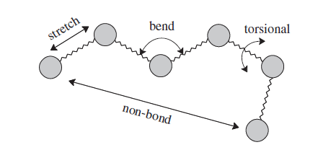
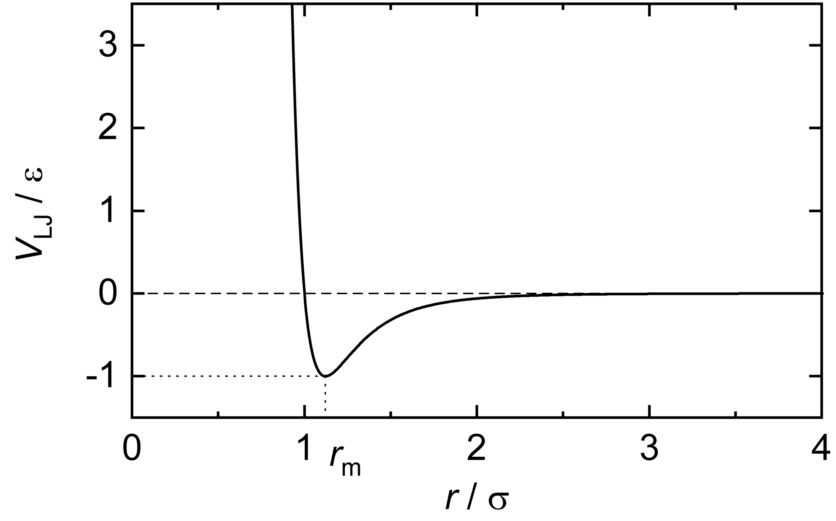
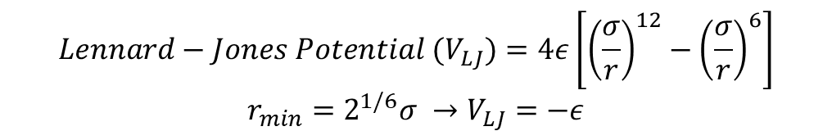
Computational Physics: Some very basic first-principles (for Ab-Initio Molecular Dynamics)
$${Lennard−Jones Potential (V}_{LJ})=4ε\left[{\left(\frac{σ}{r}\right)}^{12}−{\left(\frac{σ}{r}\right)}^{6}\right] \\ r_{min}=2^{1/6}σ →V_{LJ}=−ε$$
Image Credits: Jensen, F. (2017). Introduction to computational chemistry. John wiley & sons.
Image Credits: Lennard-Jones potential. Wikipedia.
Notes:
“r is the distance between two interacting particles, ε is the depth of the potential well, and σ is the distance at which the particle-particle potential energy V is zero” - Lennard-Jones potential. Wikipedia.

